Slide 1
How Cells Exchange Molecules
Active and Passive Transport

Slide 2
Define Diffusion
The movement of molecules from a area in which they are highly concentrated to an area in which they are less concentrated.
https://www.youtube.com/watch?v=4ZKBeEvmqzI

Slide 3
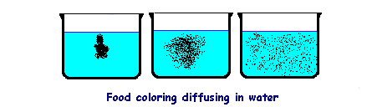
Example of Diffusion.

Slide 4

Concentration Gradient
  The concentrations of molecules at various points separate high concentrations from low create a boundary called a concentration gradient.
Low Concentration
High Concentration
Concentration Gradient
There is a concentration gradient because of the differences in concentration

Slide 5
Down or Up Gradient?
Down a concentration gradient
  HIGH concentrated to LOW concentrated
  Happens automatically without any energy added
  Sound familiar? (Diffusion)
Up a concentration gradient
  LOW to HIGH concentration
  Requires energy

Slide 6
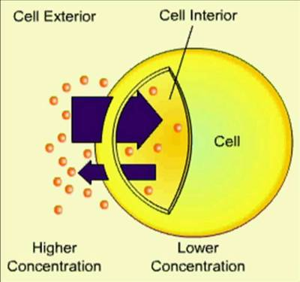
Diffusion and Cells
Diffusion: nutrients and materials through the cell
http://www.mrcorfe.com/KS4/Edexcel/Biology/B2-1-LivingCells/images/DiffusionCell.jpg

Slide 7
Diffusion and Osmosis
What determines the rate of diffusion?
Difference in concentration (concentration gradient)
  Bigger difference in concentration means faster diffusion
Temperature
  Higher temperature means faster diffusion because molecules have more energy and are moving faster.

Slide 8
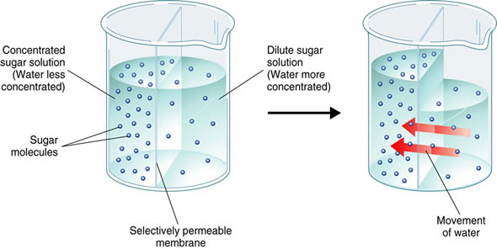
Define Osmosis
The diffusion of water across a selectively permeable membrane
WATER moves from a high concentration of water (less salt or sugar dissolved in it) to a low concentration of water
So water has to cross a selectively permeable membrane from a dilute solution to a concentrated solution
http://www.lucasbrouwers.nl/blog/wp-content/uploads/2009/11/Osmosis.jpg

Slide 9
Osmosis in Cells
Affects the size and shape of cells, by the amount of water/solutes across the membrane.
Gain/loss "pressure" like miniature balloons.
Solute: dissolved substance: a substance dissolved in another substance
Hypertonic: kids are hyper kick them out
Hypotonic: “hypo” prefix means under
Isotonic: “iso” prefix means equal

Slide 10
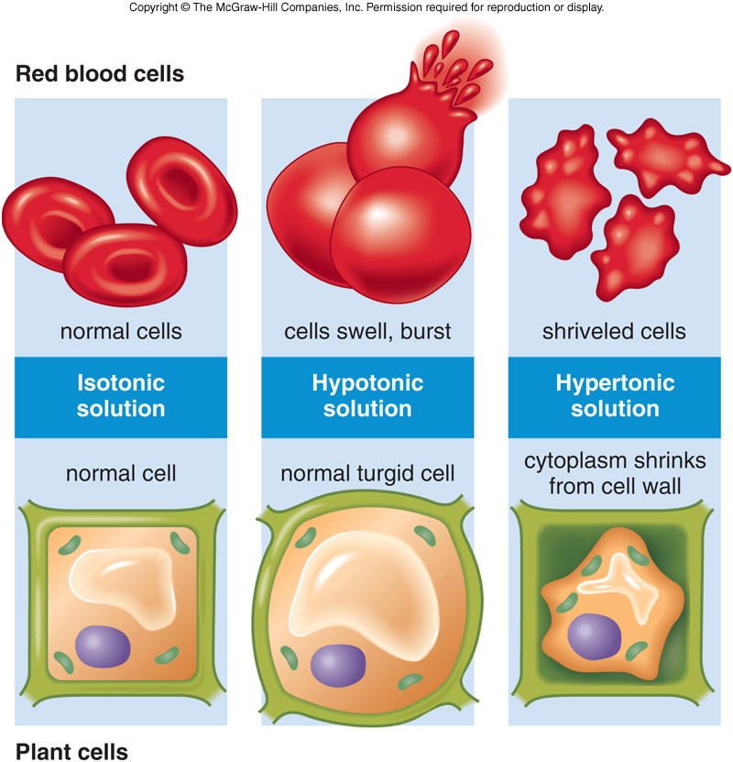
Osmosis in Cells
Hypertonic concentration of solutes is greater outside the cell than inside
Hypotonic: Concentration of solutes is greater inside the cell than outside
Isotonic: Concentration is equal
http://legacy.hopkinsville.kctcs.edu/sitecore/instructors/Jason-Arnold/VLI/Module%202/m2cellfunctionandenergetics/f5-13_osmosis_in_animal_c.jpg

Slide 11
Define Selectively Permeable Membrane
A membrane that allows only certain materials to cross it
Materials pass through pores in the membrane

Slide 12
Why Are Osmosis & Diffusion Important?
All living things have certain requirements they must satisfy in order to remain alive
  exchanging gases (usually CO₂ and O₂)
  taking in water, minerals, and food,
  eliminating wastes.
These tasks happen at the cellular level.
Molecules move through the cell membrane by diffusion

Slide 13
Active versus Passive Transport
Are biological processes that move oxygen, water, and nutrients into cells and remove waste products.

Slide 14
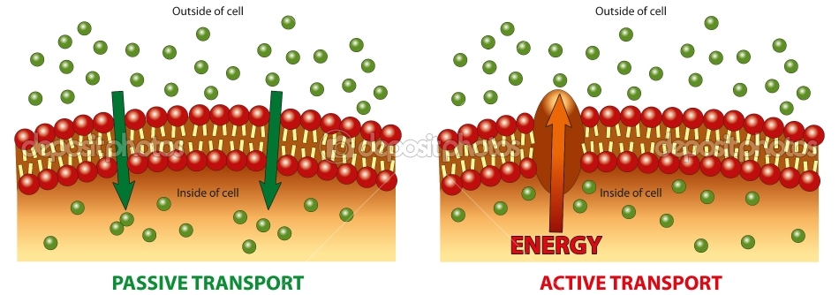
Active versus Passive Transport

Slide 15
Active versus Passive Transport
Passive transport:
Moves molecules from areas of HIGH concentration to areas of LOW concentration; so it DOES NOT require energy.
  Diffusion
  Osmosis
  Facilitated Diffusion
Active transport:
Requires ENERGY because it is the movement of molecules from areas of LOW concentration to areas of HIGH concentration.
  Uses Protein synthesis to aid

Slide 16
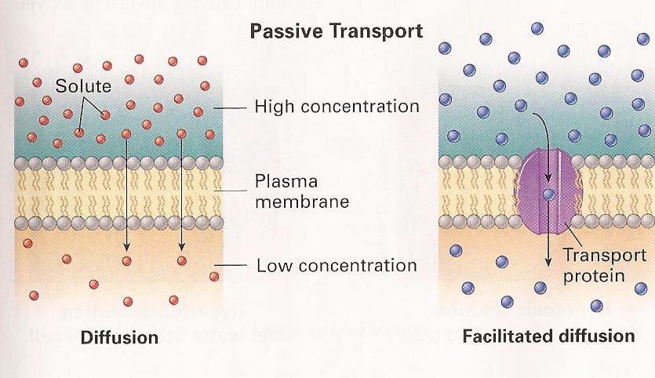
Oxygen (O₂), carbon dioxide (CO₂) and water (H₂O) can diffuse easily across the cell membrane.
Glucose (C₆H₁₂O₆), amino acids, and ions cannot diffuse through membranes.
They need to use special protein channels called transport proteins.
Transport proteins move substances down their concentration gradient, which does not require any energy.

Slide 17
Active Transport
Sometimes cells need to move substances against their concentration gradient.
This requires energy and is called active transport
During active transport, a specific transport protein pumps a solute across a membrane, against the concentration gradient
  Examples: moving Sodium and Potassium ions in animal cells; Nitrogen, phosphorus, potassium, and calcium in plant cells.
The mitochondria supplies the energy for active transport in the form of ATP.

Slide 18
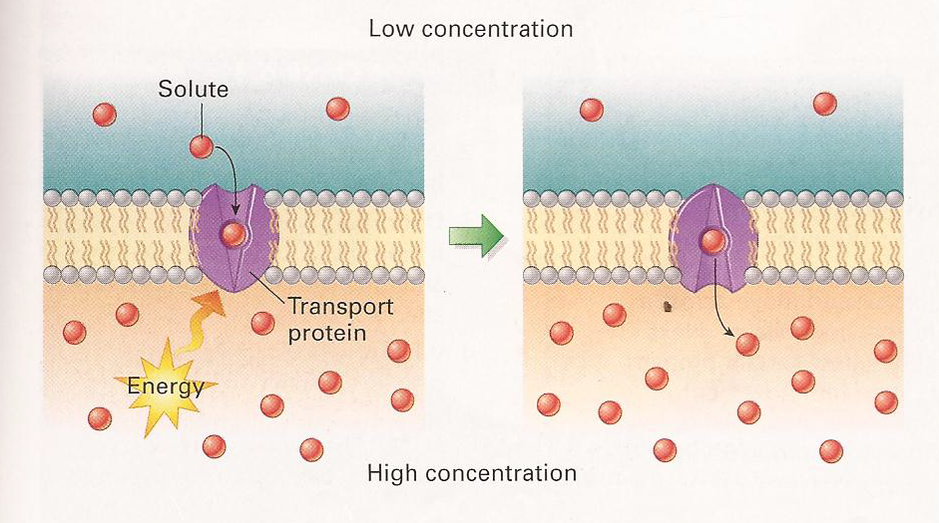
Active Transport

Slide 19
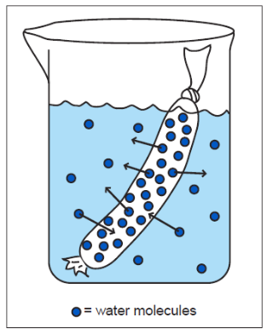
Cell Model Results
The “cell model” contains a higher concentration of solutes (ie: glucose) than the external environment. (The cell model is hypertonic compared to the external environment).
Even though there was random movement of glucose molecules both into and out of the cell model, there was a net movement of glucose molecules from the inside of the cell model to the external environment.
glucose

Slide 20
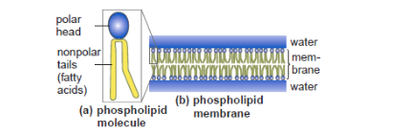
Process & Procedure #5
Lipids (fats and oils) are non-polar, which means they are hydrophobic.
The polar heads of a phospholipid associate themselves with water while the nonpolar (fatty acid) tails arrange themselves to exclude water.

Slide 22
Reflect & Connect
Molecule or Ion | How it moves through membranes | Transport type? | Energy?
Oxygen, CO2 | Small enough to move directly through the membrane | Diffusion | Passive Transport (no energy)
Water | Small enough to move directly through the membrane | Osmosis | Passive Transport (no energy)
Glucose | Too big to move directly through the cell membrane, needs a transport protein | Facilitated Diffusion | Passive Transport (no energy)
Nitrogen, Phosphorus, Potassium, Calcium (plant cells) | Moving against the concentration gradient. | Transport protein (pump) | Active Transport (energy)
Sodium & Potassium (animal cells) | Charged ions can’t go directly through the cell membrane. Also, moving against the concentration gradient. | Transport protein (pump) | Active transport (energy)

Slide 23
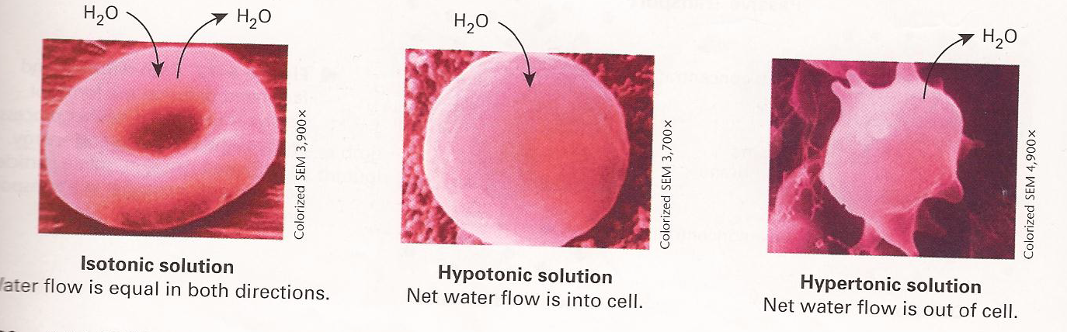
Reflect & Connect #3
Why is it a bad idea to drink seawater if you are stranded on a boat in the ocean? What do you think would happen to your cells?
Seawater is hypertonic compared to your cells because seawater contains more solute (salt). Therefore, water would move through osmosis out of your cells, reducing the concentration of water in your cells. This would lead to dehydration

